Slide 1

LA French Tech Beyrouth
Presentation
There’s never been a better time to join, found or invest in a startup in France. We have built a branch website for La French Tech and is looking for talents from all over the world to join the adventure.
Notes:
Today, fast is not optional, it is important.
Fast means beats your competitors to market.
Fast means attracts the best talent to your startup.
You're trying to build something, something great. Something that matters. You have a smart team in your startup and they want to go fast.
That's why La French Tech comes in.

Slide 2





Demo
Processes
About French Tech
Challenges
Notes:
In my presentation I will focus on four major.

Slide 3

About French Tech
*Some Clarifications*
What is « La French Tech »?
Her mission ?
How France helps Startups ?
French Tech Beyrouth ?
Notes:
It’s a unique movement bringing together startups, investors, policymakers and community builders.
It is also a name used by technologically innovative French businesses throughout the world.
To make France one of the greatest places in the world to launch and grow global companies that make sense for our future.
French Tech encompasses all start-ups, i.e. all growth companies that share a global ambition, at every stage in their development, from embryonic firms to growing start-ups with several hundred employees and their sights set on the international market. As is the case all over the world, digital technology is a major catalyst for its development.
La French Tech Beyrouth is a Part of the 63 international communities of La French Tech.

Slide 4
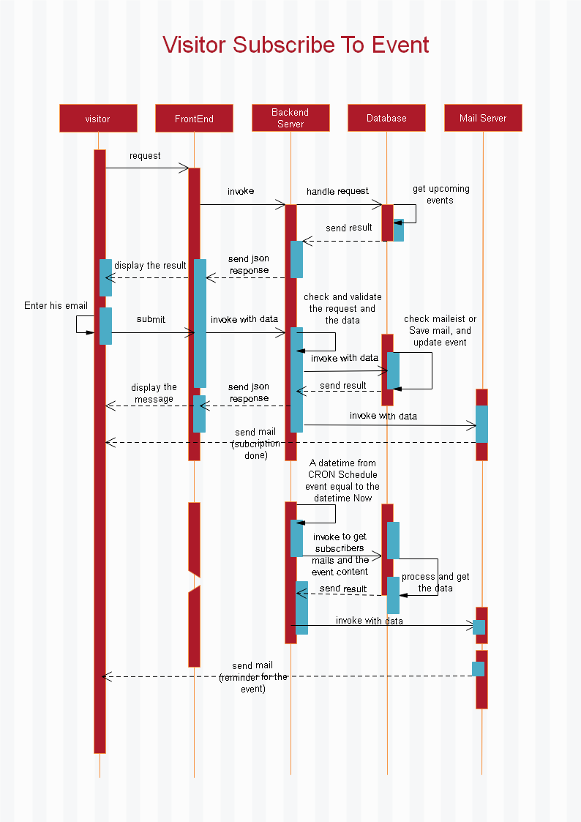
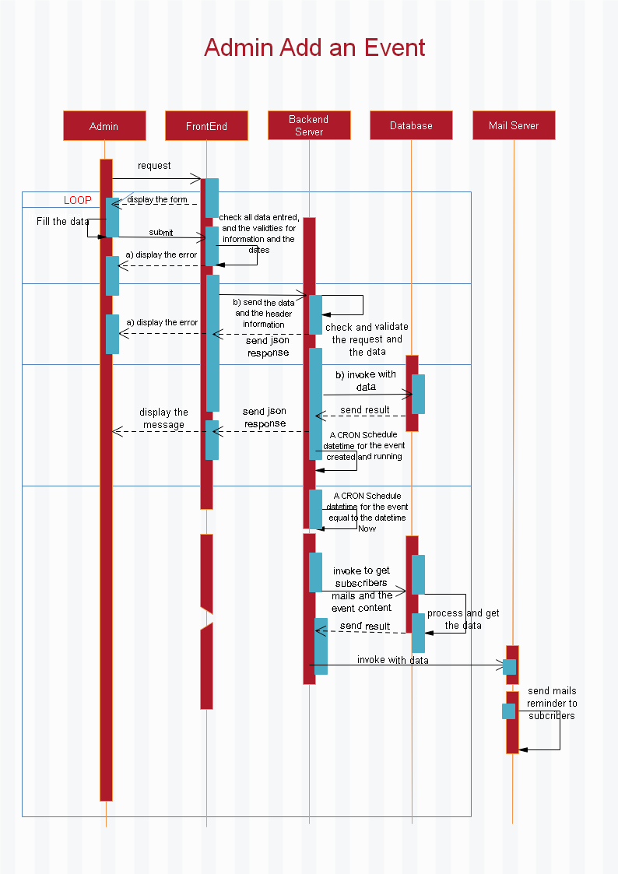
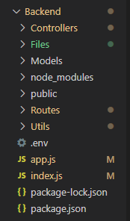
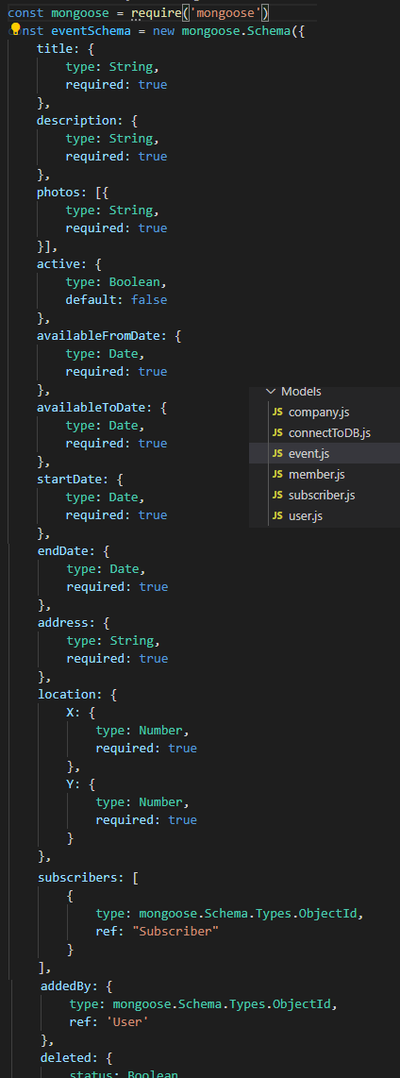
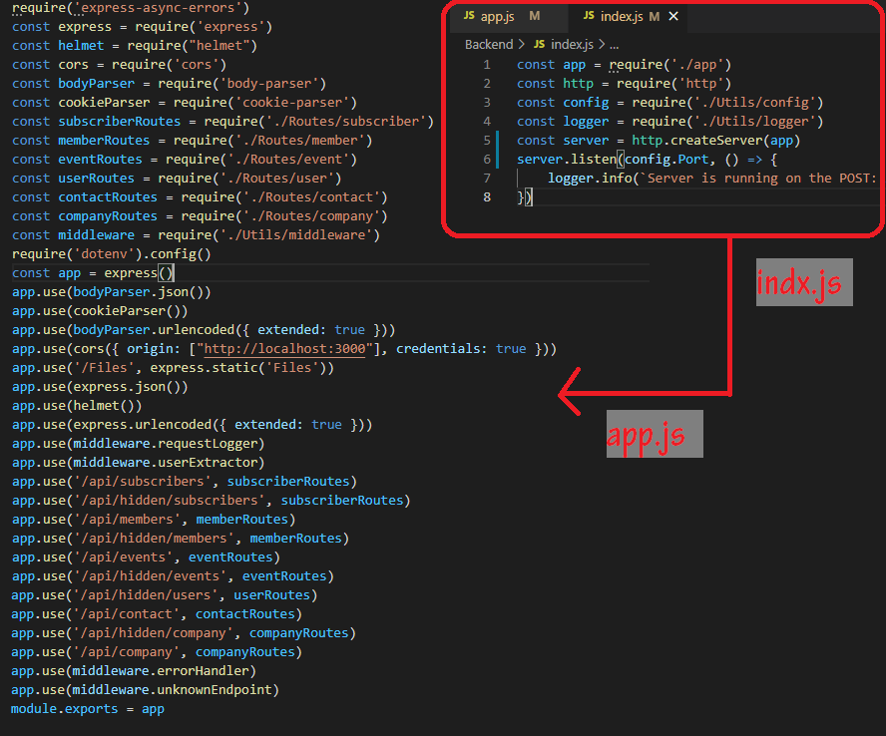
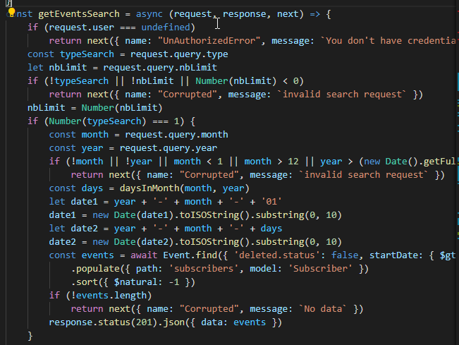
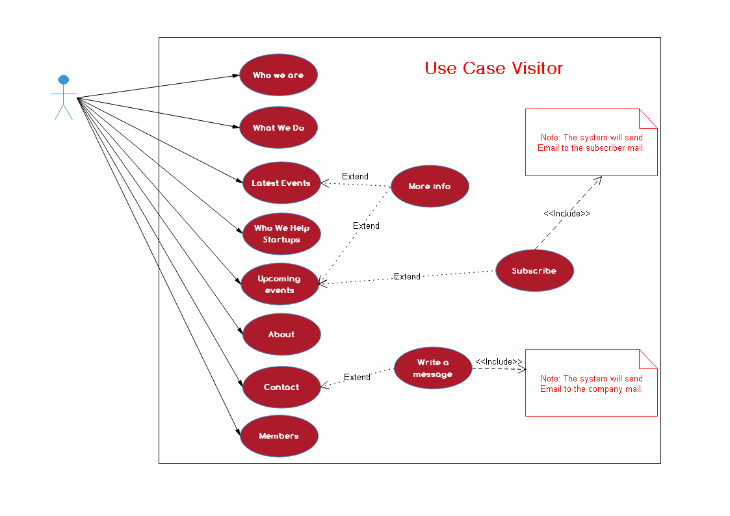
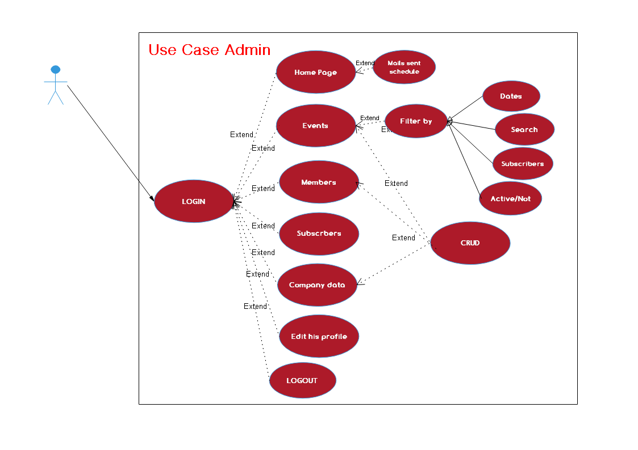
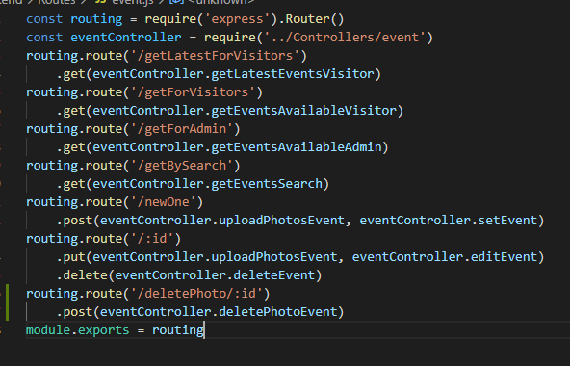
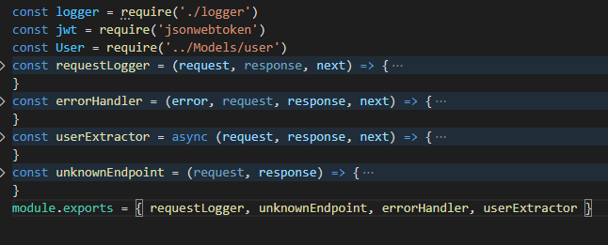
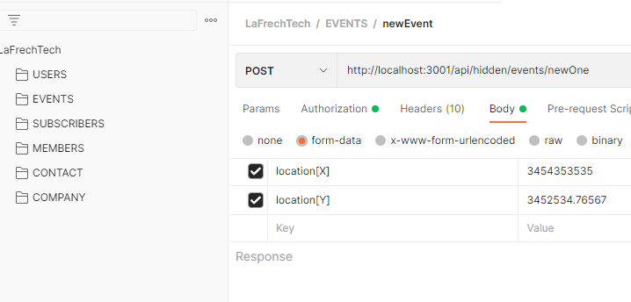
Process - Backend
1. Uml Diagram
Use case visitors
Use case admin
One sequence for visitor
One sequence for admin
2. Create Server
Http server
Middleware
3. Data base
Schemas
Controllers
Routing
4. Hierarchy
5. Testing
Postman
Notes:
A use case is a written description of how visitors and users will perform tasks on your website. A sequence diagram is a type of interaction diagram because it describes how—and in what order—a group of objects works together.
An http server also known as webserver is created on the first way for handle the requests from the user interface, as we can see I began from index.js who creates the App server with all the require modules and packages, also initialize all the api that come as requests, then config the port for listening.
Data management request, headers, authentication, and API management are all commonly handled by middleware.
A schema is a class definition for how you want data to be organized as objects in your website.
Controllers are the functions that responsible for processing the request then return response.

Slide 5
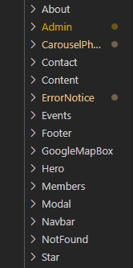
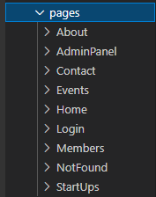
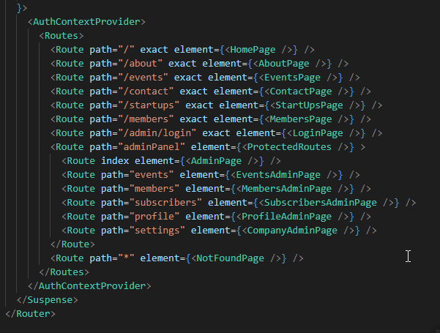
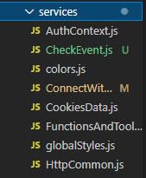
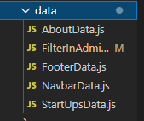
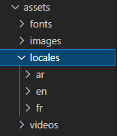
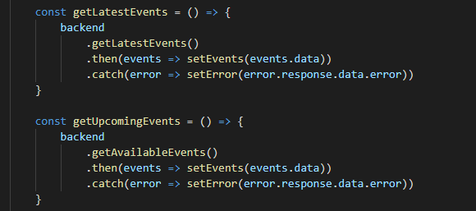
Process - Frontend
1. Set up the first step in front end
Create the react app
Install initial modules
Build the routes
2. Sketching the website
3. Create the pages
4. Create the components
5. Set up the static data for components
6. Set up the translation text
7. Set up the services data
8. Testing
Notes:
- Create a new folder for frontend and start with create the npm init for initialize the console then create the react app.
- I use my imagination and I write the whole website from scratch.
- Create and split pages and write the sections.
- Create the components, each section is a set of components, so inside the components we write how the website work, and initialize the layout using the jsx and the styled components.
- Split the static data for the website in an external pages (like the html forms, static images names, and some information).
- Put the translation words and texts in external files for smoothly using without reloading the pages.
- Create the services pages with the backend like axios, fetching methods, check authentication, and some features methods
- And finally the most wasted time was in the testing with the backend.

Slide 6
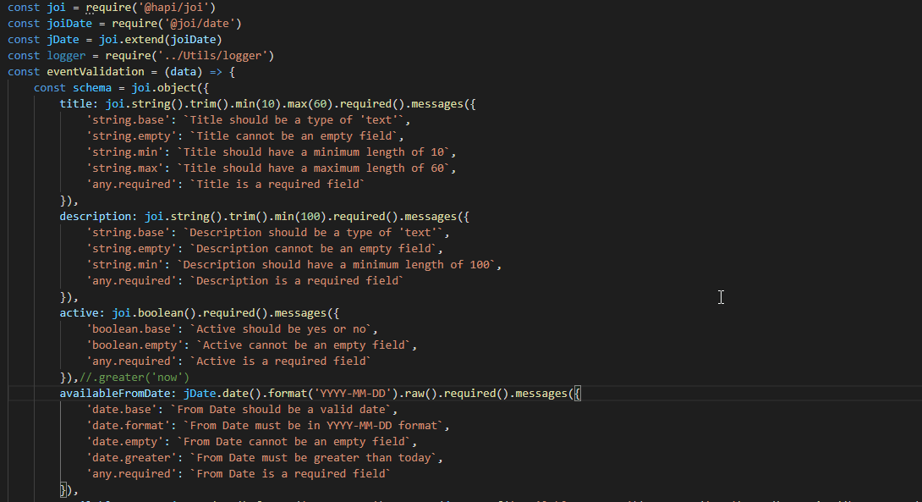
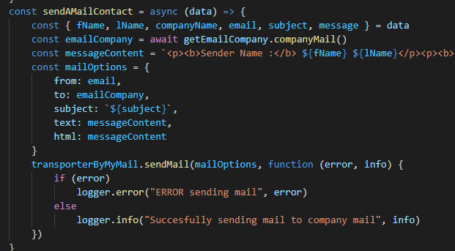
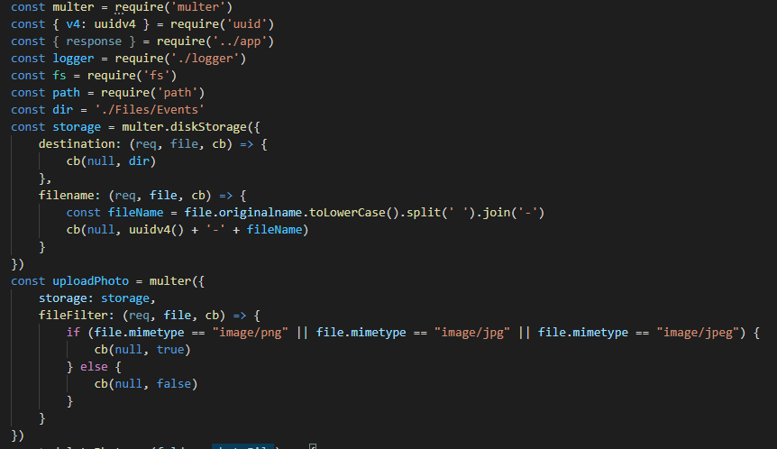
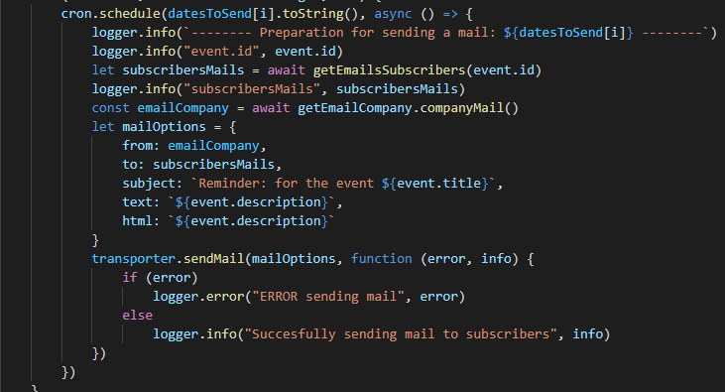
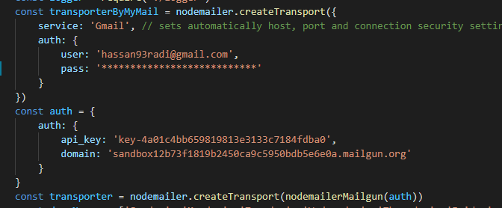
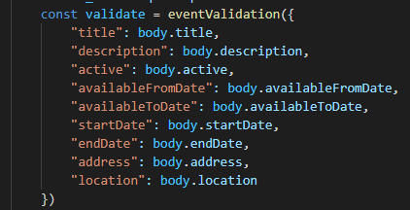
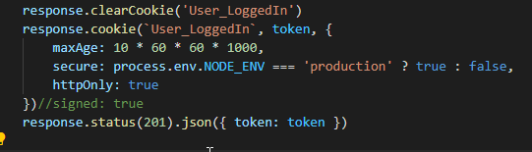
Process - Modules
Back end packages:
@hapi/joi - @joi/date:
bcrypt:
body-parser
cookie-parser
cors
dotenv
express
express-async-errors
file-system
helmet
jsonwebtoken
moment-timezone
multer
node-cron
nodemailer
nodemailer-mailgun-transport:
Uuid
Notes:
- Joi for Validation
- Bcrypt for Encryption
- Body parser for Parsing – data from requst
- Ookie parsr for parsing - cookie info
- CORS for Cross-Origin Resource Sharing for the website.
- Dotenv Set environment variables.
- Express Create the server and build the app.
- Express async errors is a Async/await error handling support for expressjs.
- File system for Save files
- Helmet for Help secure Express and Connect apps with various HTTP headers.
- Json webtoken is responsible for Create the token.
- Moment time zone for Convert the datetimezone.
- Mongoose for create Scehmas.
- Multer for Upload files.
- node-Cron for Make schedule
- Noemailer for Sending mails.
- Mailgun transporter is Transporter for the mails
- Nodemon is Automatically restart the server.
- UUID is a Unique identifier.

Slide 7
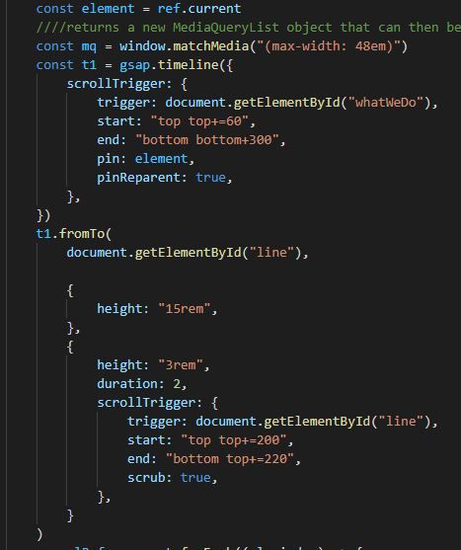
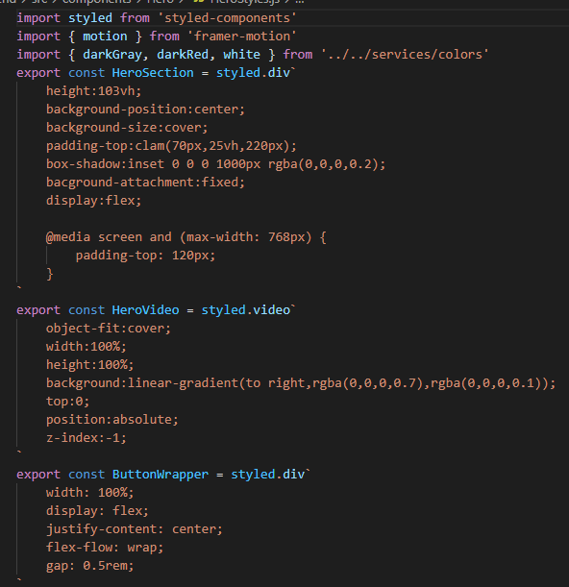
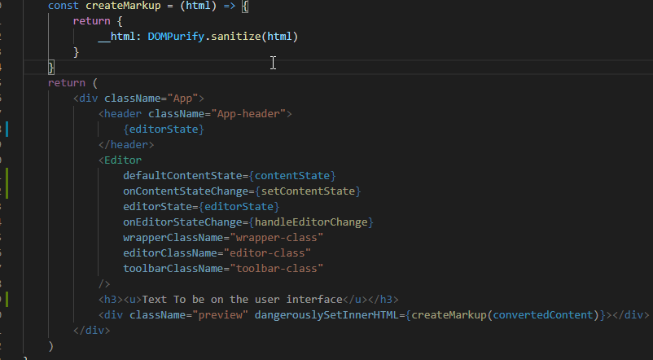
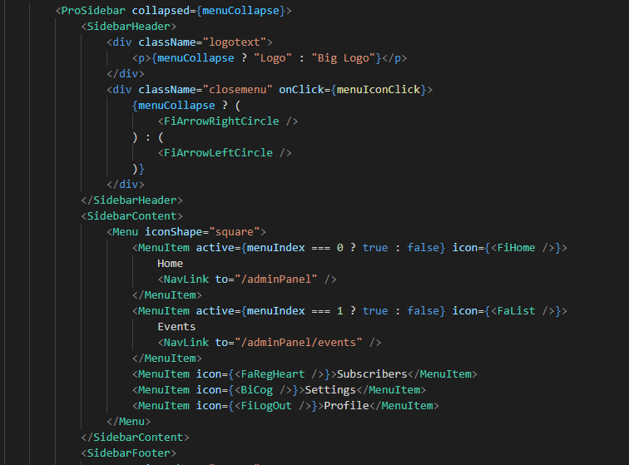
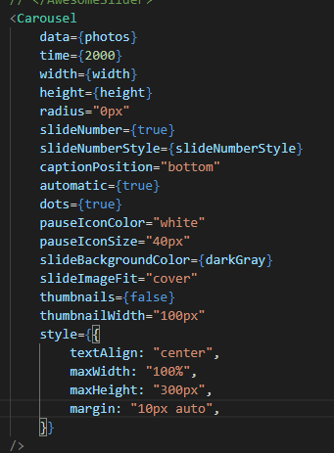
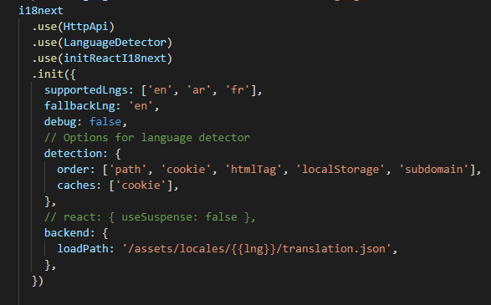
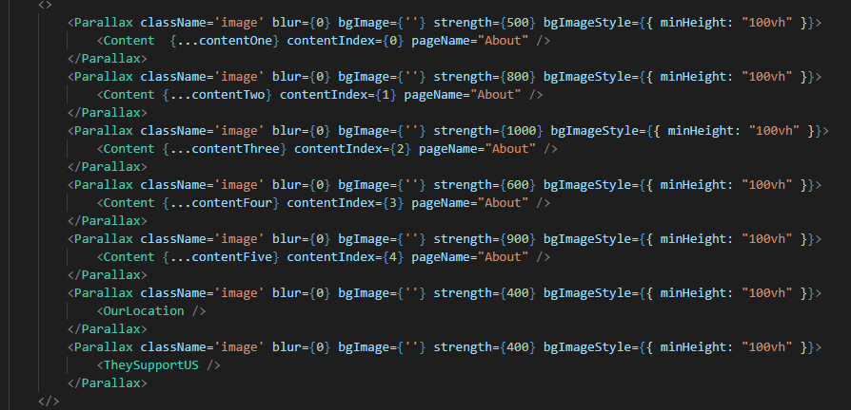
Process - Modules
Front end package:
dompurify:
draft-js:
flag-icons:
framer-motion:
gsap:
i18next:
js-cookie:
react-awesome-slider:
react-icons:
react-intersection-observer:
react-parallax:
react-player:
react-pro-sidebar:
react-router-dom:
react-scroll:
styled-components: @hapi/joi
Notes:
- DOMPurify is for sanitize HTML and prevents XSS attacks.
- DraftJS: JavaScript rich text editor framework
- Flag-icons: For Icons flags
- Framermotion: A simple and powerful React animation library.
- GSAP: Advanced Animation Techniques.
- i18next: react-i18next is a powerful internationalization framework for React
- js-cookie for saving cookie.
- Awesome slider: is a slider library.
- React icons: is a popular icon package.
- Intersection observer: is an API to tell you when an element enters or leaves the viewport.
- React parallax: create parallax scroll effects for banners
- React player: is A React component for playing a variety of URLs.
- Pro sidebar: is a ibrary with dropdown menus and unlimit number of nested submenus.
- RRD: is a standard library for routing in React.
- React scroll: React component for animating vertical scrolling.
- styled-components lets you write actual CSS in your JavaScript.

Slide 8

Challenges
1) Translation
How to translate headers, text, arrays, objects, and dates.
2) Mails
Send mails across static transporter, or platform transporter.
3) Text Editor
Best editor for allowing write and format a text.
4) Styled Component
The place for write CSS in your JavaScript
5) Heroku
Heroku is a cloud platform as a service supporting several programming languages.
Notes:
Now, how did I build my skills with this project.
- Translation: It's a fantastic challenge, that I’ve learned, in order to build cross-languages navigation in different ways: Path, Cookie, htmlTag, localstorage.
- Mails: it's the best challenge I did, it makes my website more interactive with the visitor when he subscribes to an event, and sends to him an inbox mail.
Text editor: It is the most friendly challenge, it helps me How to make formatted and styled text.
- Styled Components: The prettiest challenge I wrote, because it beautfies my components..
- Heroku: makes my work online, for that it is the most powerful one, .

Slide 9

Duration of the work
Backend:
5 days.
Frontend
12 days.
Testing and Uploading
5 days.
Notes:
5 days with fourteen cups of coffee.
Twelve days with much more coffee.
Five days with five pills of Panadol's and of course with coffee.

Slide 10

Demo
Now we can see and interact with the site.

Slide 11
T h a n k Y o u
FOR YOUR ATTENTION

